Slide 1
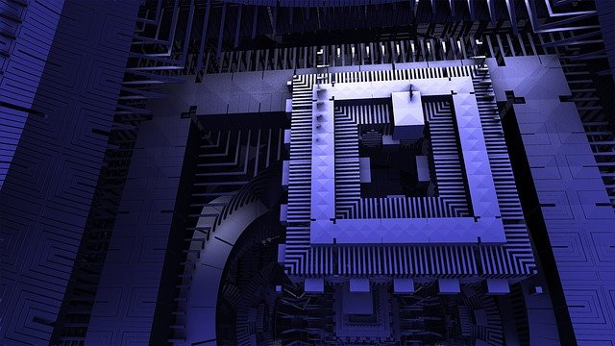
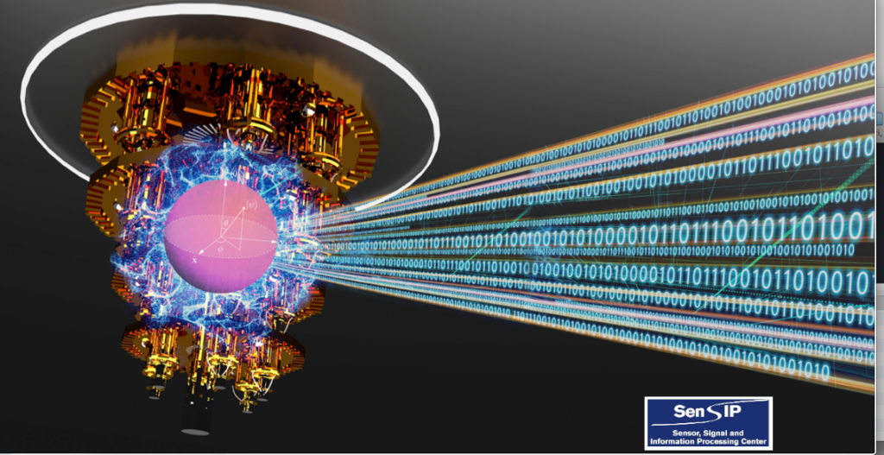


Quantum Neural Network Parameter Estimation for Photovoltaic Fault Detection

Slide 2
Agenda
Introduction to PV Fault Detection
Introduction to Hybrid Quantum Neural Network
Discussion of Approach
Preliminary Research
Comparison of approach

Slide 3
Methods for PV Fault Detection
Introduction
We introduce solar array monitoring using various machine learning methods including neural networks
In this paper, we propose a quantum circuit for a neural network implementation for Photovoltaic (PV) fault detection
Q smart monitoring device (SMD) has been developed that has sensors and actuators (relays) along with a microcontroller and an RF unit
It provides V-I, temperature, and irradiance data which can be shared on the Internet for analytics and control
We use the collected information to train and validate our model for PV Fault Detection

Slide 4
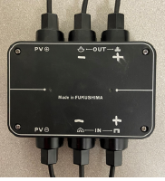
Methods for PV Fault Detection
Introducing our system
The overall system used for solar array analytics, fault detection, and topology reconfiguration is shown
Smart Monitoring Devices (SMDs) are installed one on each solar panel and provide data and the overall status on the PV array
The SMDs provide data via wireless connection and every panel has a MAC address and can be accessed after user authentication
These devices have relays and can form a switching matrix that can be used to form different panel connections

Slide 5
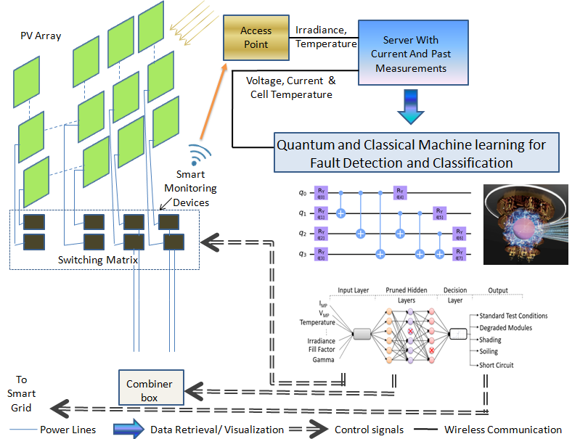
Methods for PV Fault Detection
Exploring the use of Machine Learning
Wireless sensor networks and signal processing algorithms have been used for monitoring the voltage (V), current (I), irradiance and temperature of utility scale Photovoltaic (PV) arrays [1]
These studies explored the utility of standard statistical methods such as the Mahalanobis criterion [1] and later begun exploring the use of machine learning (ML) methods for PV fault detection
Fault detection using standard K-means methods has been reported in [2, 3], neural network methods (NN) in [4, 5], and positive unlabeled (PU) learning in [6]

Slide 6
How we built our Quantum System
Hybrid Quantum Neural Network
We begin using Qiskit from IBM as our Software Development Kit (SDK)
This provides the foundation to build a quantum circuit that will run on a quantum simulator and IBMQ quantum hardware
Using the tutorial provided by Qiskit, we can quickly develop simple QML system
As we dive in more into the learning aspects, we begin changing our quantum circuit and our algorithms to see where we can improve our algorithms
Currently, we utilize both classical and quantum system to build a hybrid quantum-classical system
For this, we quickly describe a hybrid Quantum Neural Network design

Slide 7
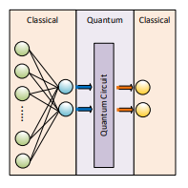
Hybrid Quantum Neural Network Example
We begin with a classical network
Here we build the quantum circuit as a hidden layer
We use the classical system as input and output to help prepare and present the data

Slide 8
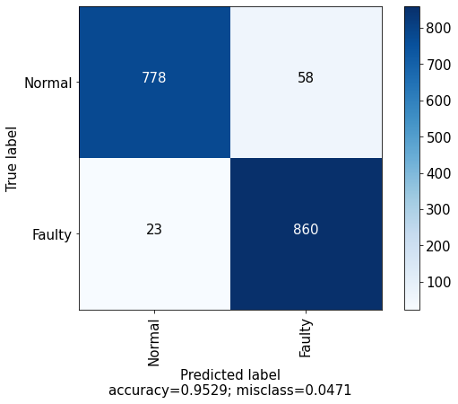
Methods for PV Fault Detection
Classical Neural Network
To compare the hybrid QNN and the classical NN, we use the confusion matrix
The classical NN is evaluated as shown is found to have an accuracy of 95.29%.

Slide 9
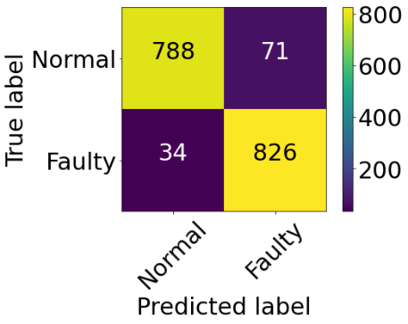
Methods for PV Fault Detection
Hybrid Quantum Neural Network
In the paper, we ran several using various number of quantum bits (qubits), epoch length and complexity of the quantum circuit
Here we present the result of 100 epochs run with 2 qubits
The accuracy is at 93.89%

Slide 10
Methods for PV Fault Detection
Comparing our Results
Here we present our testing results
We ran our quantum circuit using quantum simulator
A quantum simulator is a mathematical model that runs on classical systems
The duration shows the approximate time for computation
As we can see, the hybrid quantum neural network does show that it can process similar NN data
Fault Detection Algorithm | Training Epoch | CPU Time | Detection Accuracy
Classical NN | 300 | 20 sec | 95.39%
Hybrid QNN1 (2 qubits) | 25 | 10 hours | 87.8%
Hybrid QNN1 (2 qubits), | 100 | ~4 days | 93.89%
Hybrid QNN1 (4 qubits), | 25 | ~2 days | 90.2%
Hybrid QNN2 (2 qubits) | 18 | 8 hours | 90.5%

Slide 11
Our Next Steps
Working on optimizing the quantum circuit
Develop systems to help algorithm (machine learning) engineers to quickly realize quantum systems
Hybrid quantum-classical (CPU)
Hybrid quantum-classical (GPU/CPU)
Focus on developing new hybrid quantum neural network design that will improve our results
Staying in the Mathematical and Higher-level quantum knowledge

Slide 12
Reference
[1] Braun H, Buddha ST, Krishnan V, Tepedelenlioglu C, Spanias A, Takehara T, Yeider T, Banavar M, Takada S. Signal processing for solar array monitoring, fault detection, and optimization. Synth Lect Power Electron. 2012;4:1–95.
[2] Fazai R, Abodayeh K, Mansouri M, Trabelsi M, Nounou H, Nounou M, Georghiou GE. Machine learning-based statistical testing hypothesis for fault detection in photovoltaic systems. Sol Energy. 2019;190:405–13.
[3] Rao S, Ramirez D, Braun H, Lee J, Tepedelenlioglu C, Kyriakides E, Srinivasan D, Frye J, Koizumi S, Morimoto Y, Spanias A. An 18 kW solar array research facility for fault detection experiments. In: Proceedings of the 18th Mediterranean Electrotechnical Conference: Intelligent and Efficient Technologies and Services for the Citizen, MELECON 2016. IEEE; 2016.
[4] Rao S, Spanias A, Tepedelenlioglu C. Solar array fault detection using neural networks. In: Proceedings - 2019 IEEE International Conference on Industrial Cyber Physical Systems, ICPS 2019. Taiwan; 2019. p. 196–200.
[5] Garoudja E, Chouder A, Kara K, Silvestre S. An enhanced machine learning based approach for failures detection and diagnosis of PV systems. Energy Convers Manag. 2017;151:496–513.
[6] Jaskie K, Martin J, Spanias A. Photovoltaic Fault Detection using Positive Unlabeled Learning. Applied Sciences. 2021.

